Slide 1
DBF Winglet Trade Study
Created by Het Ghadia

Slide 2
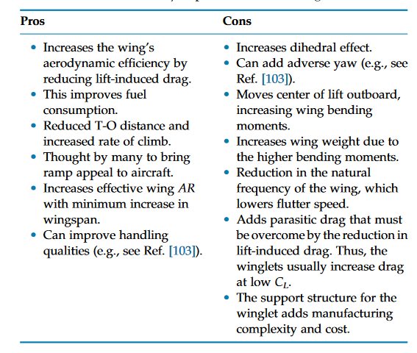
Pros and Cons of Winglets – Gudmundsson
Ref 103:
https://ntrs.nasa.gov/api/citations/19810003504/downloads/19810003504.pdf

Slide 3
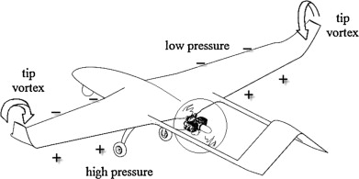
Winglet Designs
Whitcomb Winglet
Split Winglet
Blended Winglet

Slide 4
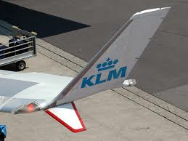
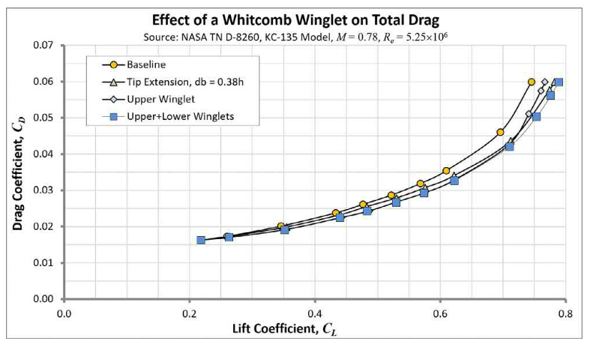
Whitcomb Winglet
First-time winglets considered on large aircraft.
Generates less drag than a wing extension
May be difficult to manufacture
Lower winglet is only small to avoid wing strike – does not have to be small

Slide 5
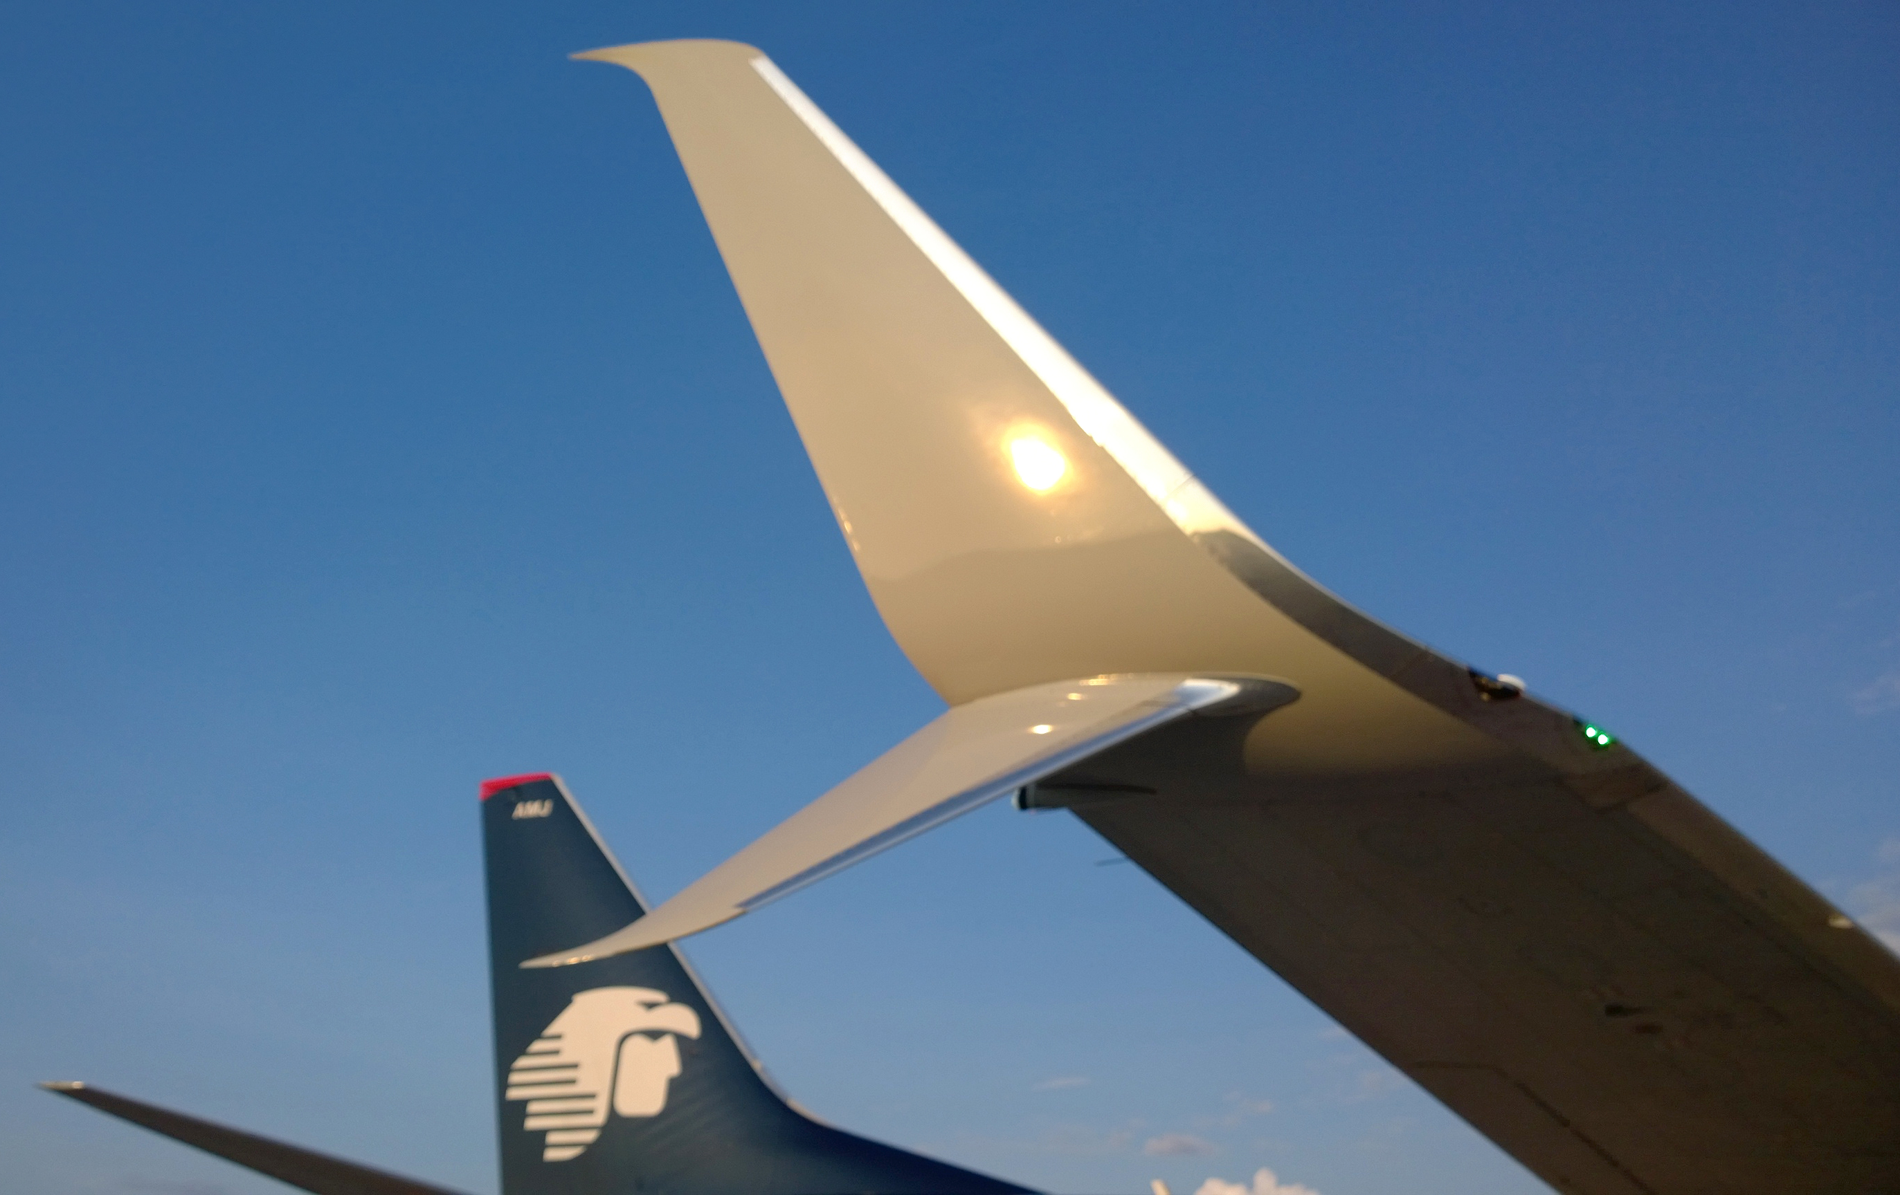
Split Winglet
The upper winglet expands the low-pressure region above the wing—the lower expands the high-pressure region below the wing. Thus, it improves the effective AR.

Slide 6

Blended Winglet -
Difference in drag is marginal compared to Whitcomb Winglet at cruise
Smoother airfoil transition from wing airfoil to winglet airfoil
Reduce pressure peaks compared to Whitcomb Design
Easier to manufacture – 3D Print

Slide 7
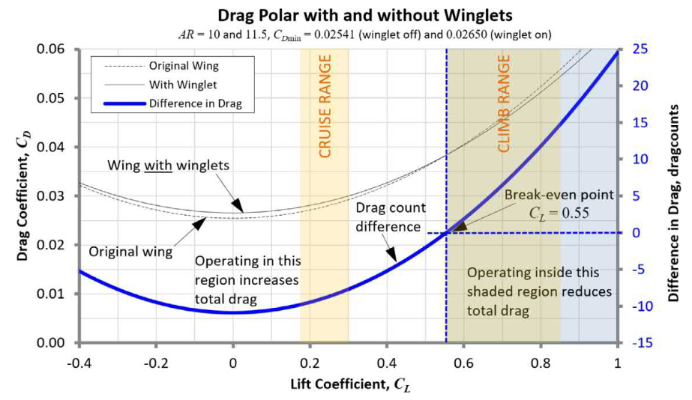

Slide 8
Conclusion
Winglet is not needed on this plane
It would be an additional weight that may not be worth the reduction on drag
And if designed wrong, it would increase drag
Having said that, a blended winglet should be chosen since it can be easier to manufacture for the plane

Slide 9
Works Cited
https://doi.org/10.1016/j.ast.2014.09.006
https://shareok.org/bitstream/handle/11244/10086/Weierman_okstate_0664M_10946.pdf;jsessionid=BF9FEEA16206F017E796C54CCC6138A0?sequence=1
Gudmundsson, General Aviation Aircraft Design, Chapter 10 p470-477

